Slide 1
DeepCare Hospital Emergency Room Report

Slide 2
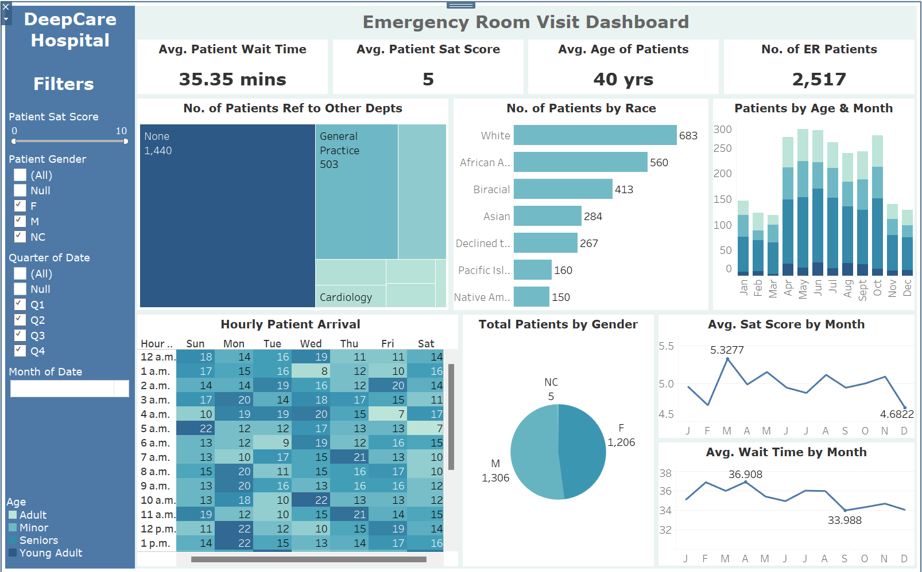

Slide 3

Insights Generated
Out of the 2000+ patients that were received in a year, 1206 are female, 1306 are male, and five preferred not to disclose;
Out of the 2000+ patients, 1440 were discharged and not referred to any department after the initial treatment was carried out;
The demographics of the hospital patients comprise more of Whites;
The Seniors make up almost 50% of the ER patients;
The Young Adults hardly get admitted to the ER, especially during the first and the last quarter of the year;
The number of patients drastically increases from April and starts to decrease by October;
The average patient satisfaction score is highest in March because that is the period when the ER department mostly has the lowest number of patients;
However, the average wait time is highest in April because of the drastic incline in the number of patients compared to the first three months;

Slide 4

Recommendations
The ER staff's leave should be mostly granted in the first and last quarter of the year as there are fewer patients to attend to;
The number of night duty staff should be increased starting from April this is because the number of ER patients increase around this time;

